Slide 1
Consumer Goods
Ad_Hoc Insights

Slide 2
Content
About Company
Problem Statement
Atliq Businss Model
Dataset
Ad-hoc request with insights

Slide 3
About Company
Atliq Hardwares is one of the leading computer hardware producers in India and well expanded in other countries too.

Slide 4
Problem Statement
Despite their growth, the company’s management has identified a significant challenge: they lack the ability to make quick, data-informed decisions due to insufficient insights..
In response to this, the company decided to expand their data analytics team and hire several junior data analysts who can provide actionable insights from data.

Slide 5
Atliq Business Model
CUSTOMERS
Croma
End user
AtliQ
Best Buy
Staples
Flipkart
Atliq e store

Slide 6
Customer Platform
Brick and Mortar
E-Commerce
Croma
Best Buy
Amazon
Flipkart

Slide 7
Customer Channel
Retailer
Direct
Distributor
Croma
Amazon
Atliq store
Atliq
exclusive
Neptune

Slide 8
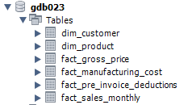
Dataset
Database:gdb023 and consist of six tables

Slide 9

Ad-hoc request -1
Provide the list of markets in which customer "Atliq Exclusive" operates its business in the APAC region.
select distinct(market) from dim_customer where customer="Atliq Exclusive" and region="APAC“
OUTPUT
Insights
There are 8 countries in which Atliq Exclusive have their business through direct channel

Slide 10
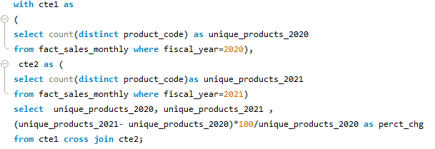

Ad-hoc request -2
What is the percentage of unique product increase in 2021 vs. 2020? The final output contains these fields, unique_products_20, unique_products_2021percentage_chg
OUTPUT

Slide 11
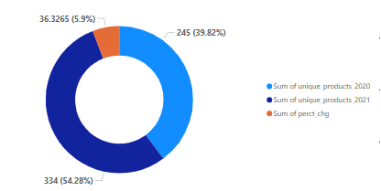
Insights with visuals
There was increase in the unique_products in 2021 by 36.33% so its positive growth indicator for business performance.

Slide 12

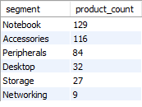
Ad-hoc request -3
Provide a report with all the unique product counts for each segment and sort them in descending order of product counts. The final output contains 2 fields: segment, product_count .
OUTPUT

Slide 13
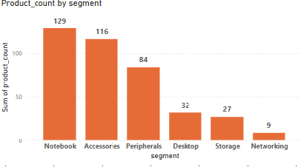
Insights with visuals
The top segment is Notebook with highest no of unique products 129 followed by Acessories Maintaining or expanding these categories could be key to continued success..
Storage and Networking
these categories have fewer products, it could be a good idea to add more options. Doing so could attract more customers and make the business stronger in these areas.

Slide 14
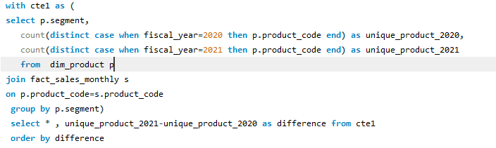
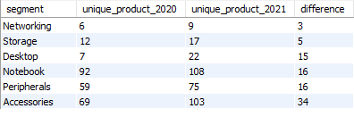
Ad-hoc request -4
Which segment had the most increase in unique products in 2021 vs 2020? The final output contains these fields, segment product_count_2020 product_count_2021 difference
OUTPUT

Slide 15
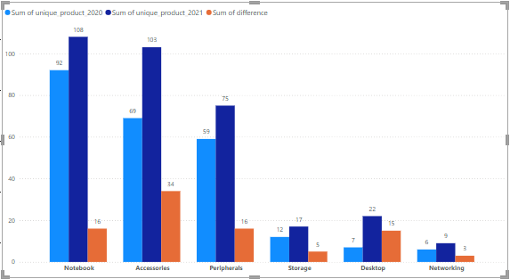
Insights with visuals
Acessories has most incease in products followed by notebook and periphals

Slide 16
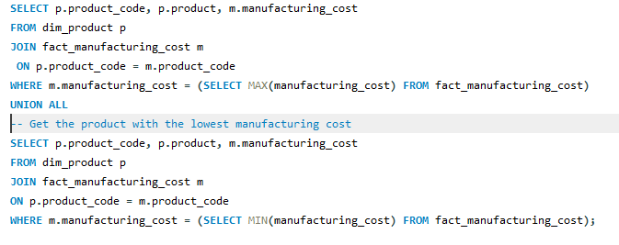

Ad-hoc request -5
Get the products that have the highest and lowest manufacturing costs. The final output should contain these fields, product_code ,product ,manufacturing_cost
OUTPUT

Slide 17
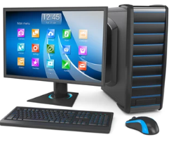

Insights with visuals
Product with highest manufacturing cost Product with lowest manufacturing cost
240.53
0.892
Product: AQ HOME Allin1 Gen 2
( Personal Desktop)
Product code:A6120110206
Product: AQ Master wired x1 Ms
(Mouse)
Product code:A2118150101

Slide 18
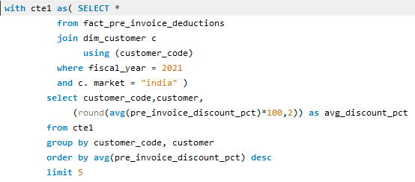
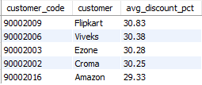
Ad-hoc request -6
Generate a report which contains the top 5 customers who received an average high pre_invoice_discount_pct for the fiscal year 2021 and in the Indian market. The final output contains these fields, customer_code,customer,average_discount_percentage
OUTPUT

Slide 19
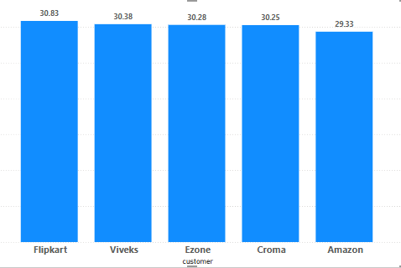
Insights with visuals
Flipkart customer received average high pre_invoice_discount_pct for the fiscal year 2021 in the Indian market.

Slide 20
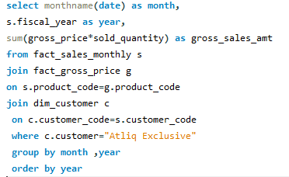
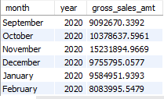
Ad-hoc request -7
Get the complete report of the Gross sales amount for the customer “Atliq Exclusive” for each month . This analysis helps to get an idea of low and high-performing months and take strategic decisions. The final report contains these columns: Month Year Gross sales Amount
OUTPUT

Slide 21
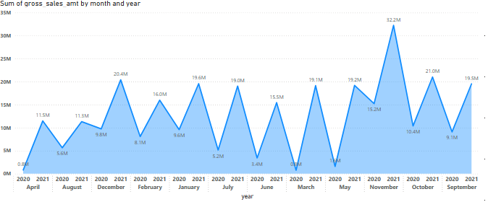
Insights with visuals
increase in gross sales from year 2020 to 2021
And in month of November 2021 its highest sale 32m and march 2020 gross sale is low 0.8m

Slide 22
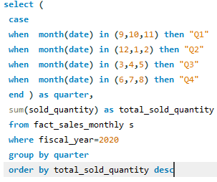

Ad-hoc request -8
In which quarter of 2020, got the maximum total_sold_quantity? The final output contains these fields sorted by the total_sold_quantity, Quarter total_sold_quantity
OUTPUT

Slide 23
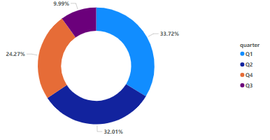
Insights with visuals
Quarter 1 has highest sold quantity in FY 2020 33.72%

Slide 24
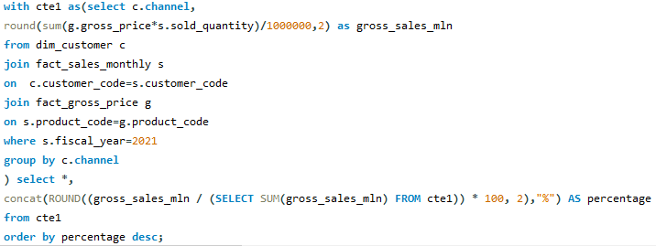

Ad-hoc request -9
Which channel helped to bring more gross sales in the fiscal year 2021 and the percentage of contribution? The final output contains these fields, channel ,gross_sales_mln ,percentage
OUTPUT

Slide 25
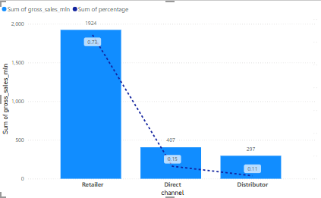
Insights with visuals
Retailer channel brought more gross sales in FY 2021 with contribution of 73.22%

Slide 26
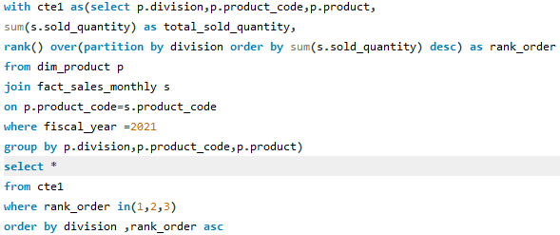
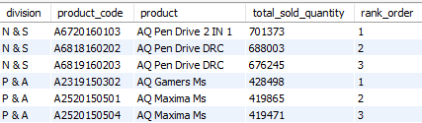
Ad-hoc request -10
Get the Top 3 products in each division that have a high total_sold_quantity in the fiscal_year 2021? The final output contains these fields: division ,product_code
OUTPUT

Slide 27
Thank You

